Slide 1
Software Design and Analysis CS3004
Engr. Muhammad Umer Haroon

Slide 2
Lecture
Design Patterns

Slide 3
WHY DESIGN PATTERNS?

Slide 4
You have already mastered SOLID principles; the rules for writing good classes.
You know how to draw UML class diagrams, trace execution with sequence diagrams, model workflows with activity diagrams, and capture state transitions with state machines.
So why introduce yet another layer of knowledge?

Slide 5
The answer is simple: principles tell you what to aim for; patterns show you how to get there.

Slide 6
The Problem of Recurring Design Problems
Every large software system faces a small set of recurring problems:
How should objects be created without hard-coding their exact classes?
How can two incompatible interfaces be made to work together?
How can an object change its behavior at runtime without using giant if-else trees?
How can one part of the system be notified when another part changes?

Slide 7
Experienced engineers solved these problems decades ago. Design patterns are their reusable, named, peer-reviewed solutions — a shared vocabulary that makes collaboration faster and code reviews more meaningful.

Slide 8
Example scenario
You're working on a project and need to create 100 similar objects efficiently. You write code, but later discover it's slow and hard to maintain. Your colleague says, 'Why didn't you just use a Factory Pattern?

Slide 9
Every developer faces similar problems repeatedly
Without patterns, we create ad-hoc solutions that are:
Hard to understand
Difficult to maintain
Prone to errors
Not reusable

Slide 10
What is a Design Pattern?
A design pattern is a general, reusable solution to a commonly occurring problem within a given context in software design.

Slide 11
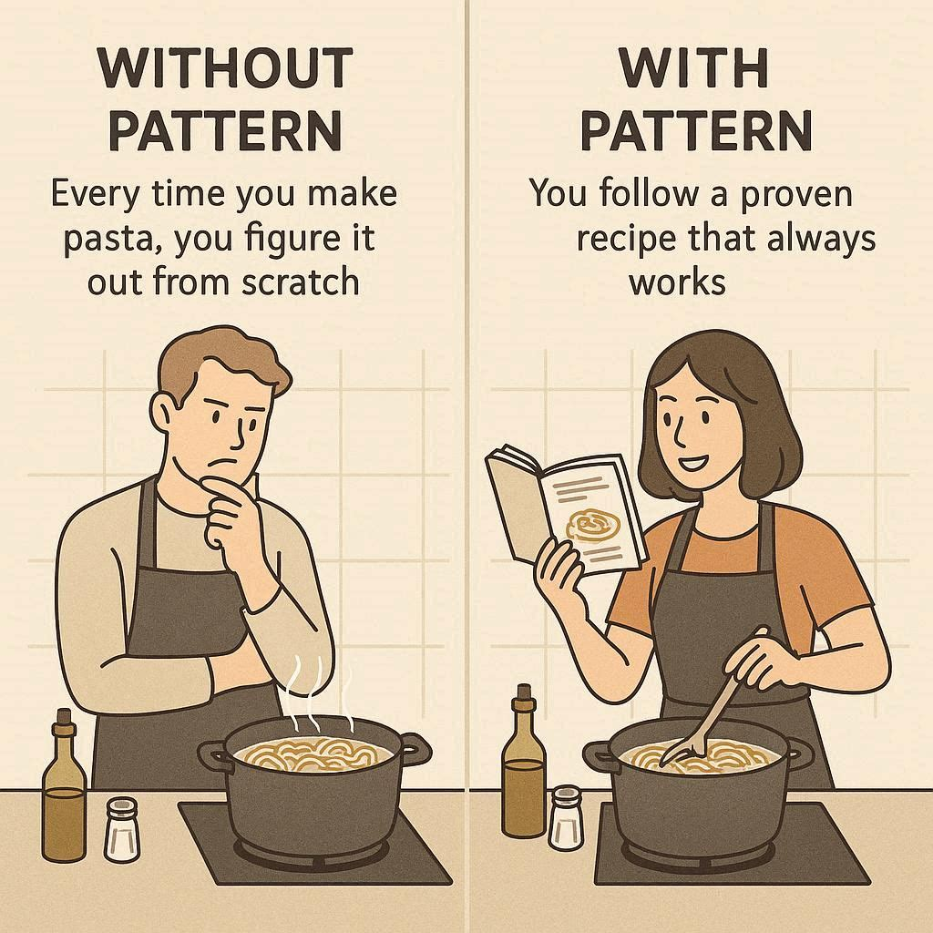
Cookbook Recipe vs. Improvisation:

Slide 12
Benefits of Design Patterns (The "Why")
Maintainability — Change one class without touching others
Scalability — Add new features by adding new classes, not editing old ones
Flexibility — Swap algorithms, implementations, or behaviors at runtime
Communication — Say "use a Strategy here" instead of a 10-minute explanation
Testability — Patterns encourage coding to interfaces, making mocking trivial
Notes:
When your code depends on interfaces, you can easily substitute the real implementation with a mock or stub during unit testing. For example, if a PaymentProcessor depends on an IPaymentMethod interface, you can inject a fake MockPaymentMethod in tests instead of calling a real credit card API.
“Making mocking trivial”: Because the dependency is abstract, mocking frameworks (like Mockito in Java or Google Test in C++) can quickly generate fake objects that behave like the interface. This makes it straightforward to isolate the unit under test and verify its behavior without relying on external systems.

Slide 14
The Three Categories of Problems Patterns Solve
Problem Type | Example | Pattern Solution
Creation | How to create objects flexibly? | Factory, Singleton
Structure | How to compose objects? | Adapter, Decorator
Behavior | How objects communicate? | Observer, Strategy

Slide 15
Signs You Need Design Patterns
Code in next slide ..

Slide 16
// ❌ WITHOUT Pattern - Code Smells
class BadExample {
// Problem 1: Hard-coded object creation
DatabaseConnection db1 = new DatabaseConnection("localhost");
DatabaseConnection db2 = new DatabaseConnection("localhost");
DatabaseConnection db3 = new DatabaseConnection("localhost");
// Problem 2: Tight coupling
PayPalPayment payment = new PayPalPayment();
// Problem 3: No flexibility
if(userType.equals("admin")) {
// Duplicate code everywhere
}
}
// WITH Pattern - Clean Solution
class GoodExample {
// Singleton Pattern - One connection
DatabaseConnection db = DatabaseConnection.getInstance();
// Strategy Pattern - Flexible payment
PaymentStrategy payment = PaymentFactory.getPayment("paypal");
}

Slide 17
The Gang of Four (GoF) Design Patterns
Who Are the Gang of Four
The Authors:
Erich Gamma ,Richard Helm,Ralph Johnson , John Vlissides
Their Book: "Design Patterns: Elements of Reusable Object-Oriented Software" (1994)
Impact:
500,000+ copies sold
Cited in 50,000+ research papers
Foundation of modern software solutions

Slide 18
The 23 GoF Patterns - Complete Map
CREATIONAL How objects are created | STRUCTURAL How objects are composed | BEHAVIORAL How objects communicate
• Singleton • Factory Method • Abstract Factory • Builder • Prototype | • Adapter • Bridge • Composite • Decorator • Facade • Flyweight • Proxy | • Chain of Responsibility • Command • Iterator • Mediator • Memento • Observer • State • Strategy • Template Method • Visitor • Interpreter

Slide 19
When to Use (and NOT Use) Patterns

Slide 20
Signs You SHOULD Use a Pattern
You've solved the same problem before
Code is becoming hard to change
You need flexibility for future requirements
Multiple developers will work on the code
You hear yourself saying "There must be a better way"

Slide 21
Signs You Should NOT Use a Pattern
The problem is trivial (3 lines of code)
You're "pattern hunting" (forcing patterns where not needed)
The solution adds more complexity than value
The requirements are 100% fixed forever (rare!)
Your team doesn't understand the pattern

Slide 22
The "Goldilocks" Rule
Too Little Pattern: Spaghetti code, hard to maintain
JUST RIGHT: Balanced use of patterns
Too Much Pattern: Over-engineering, complexity

Slide 23
For interest only
The Goldilocks Rule states that humans experience peak motivation when working on tasks that are neither too easy nor too hard, but just right.
Will add a link ………….

Slide 24
Final Checklist for Your Projects
Have I solved this problem before?
Is there a GoF pattern for this?
Will this code need to change in the future?
Is the pattern adding value, not complexity?
Does my team understand the pattern?

Slide 25
Is there a problem or problems
class MessyOrderSystem {
void processOrder(String paymentType) {
if(paymentType.equals("credit")) {
CreditCardProcessor cc = new CreditCardProcessor();
cc.charge(100);
cc.sendReceipt();
} else if(paymentType.equals("paypal")) {
PayPalAPI pp = new PayPalAPI();
pp.makePayment(100);
pp.emailConfirmation();
} else if(paymentType.equals("crypto")) {
BitcoinWallet btc = new BitcoinWallet();
btc.transfer(100);
btc.logTransaction();
}
}
}

Slide 26
Tight Coupling
The processOrder method directly instantiates CreditCardProcessor, PayPalAPI, and BitcoinWallet.This ties your code to specific payment implementations, making it hard to extend or replace them later.

Slide 27
Violation of the Open/Closed Principle
Every time you add a new payment type (e.g., ApplePay), you’ll need to modify processOrder and add another else if.The class is not “open for extension, closed for modification.”

Slide 28
Lack of Abstraction
There’s no common interface for payment processors. Each branch uses different method names (charge, makePayment, transfer), so the calling code must know the details of each API.This defeats polymorphism and makes the code brittle.

Slide 29
Hard‑Coded Logic
Payment types are checked with string comparisons ("credit", "paypal", "crypto").This is error‑prone (typos break logic) and not type‑safe.

Slide 30
Poor Maintainability
Adding new payment methods means editing this method, risking regressions. Testing becomes harder because you can’t easily mock or substitute payment processors.

Slide 31
Possible improvements
Define a PaymentProcessor interface with a common method (e.g., processPayment(amount)).
Implement concrete classes (CreditCardProcessor, PayPalProcessor, CryptoProcessor) that adhere to this interface.
Use a Factory or Strategy Pattern to select the right processor at runtime without if‑else chains.
This way, MessyOrderSystem only depends on the abstraction, not the concrete classes.

Slide 32
Are design patterns just for Java?
No! Patterns are language-agnostic. They work in Python, C++, JavaScript, etc

Slide 33
Do I need to memorize all 23 ?
No! Start with 5-6 common ones. You'll learn others as needed.

Slide 34
Can patterns make my code slower?
Slightly, but maintainability gains far outweigh tiny performance costs

Slide 35
Why companies like Google, Netflix, and Amazon rely on these patterns to build software that serves billions of users ?

Slide 36
Industry Case Studies
Case 1: Netflix
Pattern Used: Strategy Pattern
Problem: Different video quality based on bandwidth
Solution: Swap compression algorithm at runtime
Result: 200+ million users, seamless streaming

Slide 37
Case 2: Amazon
Pattern Used: Observer Pattern
Problem: Notify millions of customers about price drops
Solution: Subscribe/notify architecture
Result: Real-time price alerts, increased sales

Slide 38
Case 3: Spotify
Pattern Used: Factory Pattern
Problem: Support multiple audio formats (MP3, AAC, OGG)
Solution: Factory creates appropriate decoder
Result: 400+ million users, any format works

Slide 40
If you were like any one else ,why were you created then ?
You have got a purpose , find it before its late …too late.
REMEMBER IN PRAYERS
Engr. Muhammad Umer Haroon

